Slide 1
Environmental Test
DFH SATELLITE CO.,LTD
February, 2019

Slide 2
Content
What is Environmental Test
What is Dynamic Environment
Dynamic Test Matrix and Level
Dynamic Test Example
Exercise

Slide 3
Content
What is Environmental Test
What is Dynamic Environment
Dynamic Test Matrix and Level
Dynamic Test Example
Exercise

Slide 4
Environmental Test
Test
Testing is generally the method to verify that hardware items meet allocated system requirements during and following exposure to applicable environments.
Testing includes an explicit measure of performance during exposure to an applicable environment, or it may be a measurement coupled with an analysis or other demonstration.

Slide 5
Environmental Test
Environment
The complex flight environment involves a combination of conditions that are usually resolved into individual test environments.
Each test environment should be based on actual flight data, scaled if necessary for differences in parameters, or if more reliable, by analytical prediction or a combination of analysis and flight data. The flight data may be from the current flight system, or from other flight systems if configuration variations are accounted for and properly scaled.

Slide 6
Environmental Test
Test category by purpose
Development Tests
Qualification Tests
Acceptance Tests

Slide 7
Environmental Test
Test category by purpose
Development Tests
It is an engineering characterization test
validate new design concepts or the application of proven concepts and techniques to a new configuration.
assist in the evolution of designs from the conceptual phase to the operational phase.
reduce the risk involved in committing designs to the fabrication of qualification and flight model.
validate qualification and acceptance test procedures.
Investigate problems or concerns that arise after successful qualification.

Slide 8
Test purpose
Qualification Tests. The purpose of a qualification test is to demonstrate with margin that a hardware design is adequate to perform as are required throughout the mission (pre-flight and flight) environmental exposures. It is usually applied to a single item of prototype hardware that will not be flown, and is commonly a contractual requirement where a well documented test specification is involved. Developmental tests are sometimes carried out on prototype hardware to identify and correct design problems before the formal qualification test is performed. Also, qualification test requirements might be based upon a general environmental test specification. However, contracts usually allow deviations from the specified test levels and/or durations in general environmental test documents, if it can be established that different test conditions would be more suitable for the given hardware. In any case, the basic purpose of a qualification test requires that the test conditions conservatively simulate the basic characteristics of the anticipated dynamic excitations in the service environments
Notes:
In earlier days when test facilities were more limited, it was argued that a dynamic environment for aerospace hardware could be simulated for qualification test purposes in terms of the damaging potential of the environment, without the need for fidelity of the test excitation to the detailed characteristics of the environment . the random vibration during liftoff could be simulated with a swept sinusoidal vibration designed to produce the same mechanical damage.
Such equivalent damage concepts require the assumption of a specific mode of failure and a damage model to arrive at an appropriate excitation level and duration .Since the assumed mode of failure and damage model might be incorrect for the equipment of interest, there is a substantial increase in the risk that the resulting test criteria will severely undertest or overtest the equipment. With the increasing size and flexibility of modern test facilities, the use of equivalent damage concepts to arrive at test criteria is rarely required and is not recommended. Specifically, when feasible, qualification tests should be performed using an excitation that has the same basic characteristics as the dynamic environment of concern, e.g., random vibration environments should be simulated with random vibration excitations, transient environments should be simulated with transient excitations of similar duration, etc.

Slide 9
Environmental Test
Test category by purpose
Qualification Tests
Qualification tests will be conducted to demonstrate that the design, manufacturing process, and acceptance program produce mission items that meet specification requirements.
In addition, the qualification tests will validate the planned acceptance program including test techniques, procedures, equipment, instrumentation, and software. The qualification test baseline will be tailored for each program. Each type of flight item that is to be acceptance tested will undergo a corresponding qualification test

Slide 10
Acceptance Tests. An acceptance test is applied to all items of flight hardware,
whose design integrity has previously been verified by a qualification test on a prototype item.The goal is to detect workmanship errors and/or material defects in the manufacture and assembly of the hardware, and to demonstrate that the hardware is representative of the qualified design. There are two basic approaches to acceptance testing for dynamic environments. The first approach is to devise a test that will quickly reveal common workmanship errors and/or material defects as determined from prior experience and studies of
failure data for similar hardware, independent of the dynamic excitations in the service environments.
Notes:
For example, if a specific type of electrical equipment has a history of malfunctions induced by scrap-wire or poorly soldered wire junctions, then the application of a
sinusoidal vibration at the resonance frequencies of wire bundles will quickly reveal such
problems and, hence, constitutes a good test excitation even though there may be no sinusoidal
vibrations in the service environment. The second and more common approach for space
vehicle hardware is to apply an excitation that simulates the dynamic environments anticipated
during service, similar to the qualification test, but usually at a less conservative (lower) level
and a shorter duration.

Slide 11
Environmental Test
Test category by purpose
Acceptance Tests
Acceptance tests will be conducted as required to demonstrate the acceptability of each deliverable item. The tests will demonstrate conformance to specification requirements and provide quality-control assurance against workmanship or material deficiencies.
Acceptance testing is intended to stress screen items to precipitate incipient failures due to latent defects in parts, materials, and workmanship.
Acceptance tests are conducted to demonstrate satisfactory performance of flight systems relative to the expected environment and to reveal inadequacies in workmanship and material integrity.

Slide 12
Content
What is Environmental Test
What is Dynamic Environment
Dynamic Test Matrix and Level
Dynamic Test Example
Exercise

Slide 13
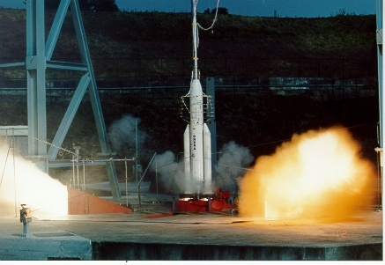
What is Dynamic Environment?
Satellite will endure various kinds of dynamic environment (Vibration, Acoustic, Shock, etc) in the whole lifespan, especially in the launching phase
Notes:
动力学环境包括振动冲击噪声等。

Slide 14
INFLUENCE ?
Above environment may cause structure deformation or damage to satellites
Electronic components damage
Broken electronic circuit
Connector loosening and rack breaking
Damage of the main structure and substructure
Statically 30%~60%
Affect performance of satellites and even cause a complete failure of the whole flight mission
Ground Dynamic Environment Test is important and necessary
Notes:
Above environment may cause structure deformation or damage to satellites
环境对航天结构造成破坏
These failures may affect the performance of satellites and even cause a complete failure of the whole flight mission
In order to guarantee the reliability and the stability of satellite structure and payload in the whole lifespan, it is essential to conduct dynamic environment test in design and manufacturing processes.
First of all, mathematical model of the satellite structure should be built. Various responses under the predicted dynamic environment are calculated and analyzed to check whether the satellite meets the design requirements, including displacement, velocity, acceleration, stress or strain.
On the other hand, the environment test needs to be performed by the method of environmental simulation. It is required that test environment produced by test equipments must be similar to the real environment as closely as possible.

Slide 15
Objective of Dynamic Environment Test?
verify whether satellite structure endure various environment
To verify design of satellite structure
To discover potential defects of material and component
To study the effect of dynamic environment on the new material and new structure
reduce the early failure and increase the in-orbiting reliability
study the effectiveness of various vibration isolation
Notes:
In order to guarantee that satellite structure, subsystems and units can endure the possible dynamic environment, it is essential to conduct sufficient environment test in addition to the well design, manufacturing and assembly.
验证设计，发现缺陷，研究新材料新结构等
To verify the design of satellite structure and verify whether satellite structure can endure various dynamic environment
To discover the potential defects of material and component in the process of the manufacturing and assembly in order to reduce the early failure and increase the in-orbiting reliability
To study the effect of dynamic environment on the new material and new structure and to study the effectiveness of various vibration isolation and attenuation measures

Slide 16
Environmental Test
Dynamic Test
In life cycle of a spacecraft, there are all kinds of dynamic environment such as transportation, rocket motor ignition overpressure, liftoff release, engine trust transients, pogo, liquid sloshing in tanks, flight operation.
It is hard to simulate these environment directly, therefore, we must summarize all dynamic environment into some type of excitation, and predict the response of spacecraft.
As one of large environmental test series after assembly and integration of satellite, acoustic and vibration test are important part of reliability validation test for satellite.

Slide 17
Environmental Test
Dynamic Test
The satellite must be undergone a vibration test on ground. the test is a method to simulate the real vibration environment of launching process.
The vibration test is one of most effective methods to disclose the potential trouble. Indicated by the trouble statistic data of NASA from 57 satellites in the first day after launch, 44 percent of trouble were induced by the vibration environment.

Slide 18
Environmental Test
Dynamic Test
Therefore, a launching satellite must be verified by a vibration test as whole spacecraft according to present production mode.
Vibration test generally is composed of swept-sine vibration test and random vibration test/acoustic test.

Slide 19
Environmental Test
Purpose of vibration and acoustic test
The vibration test and acoustic test simulate the flight or minimum workmanship screen acoustic environment and the induced vibration on units in order to expose material and workmanship defects that might not be detected in a static test condition.

Slide 20
Content
What is Environmental Test
What is Dynamic Environment
Dynamic Test Matrix and Level
Dynamic Test Example
Exercise

Slide 21
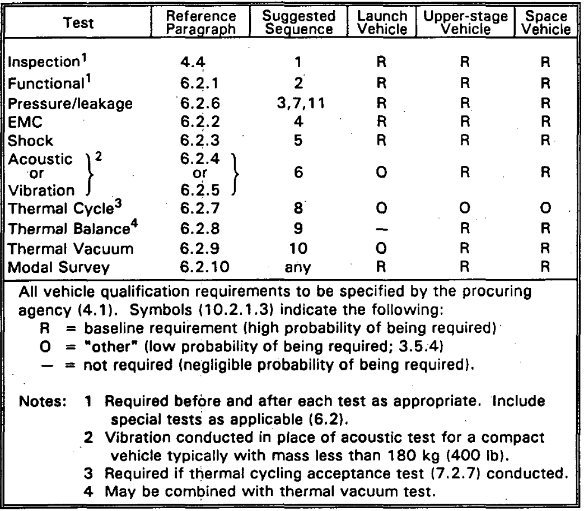
Test matrix
表2 MIL-STD-1540C（美军标）^{[2]}系统级验收试验矩阵
Vehicle Qualification Test Baseline from MIL-STD-1540C

Slide 22
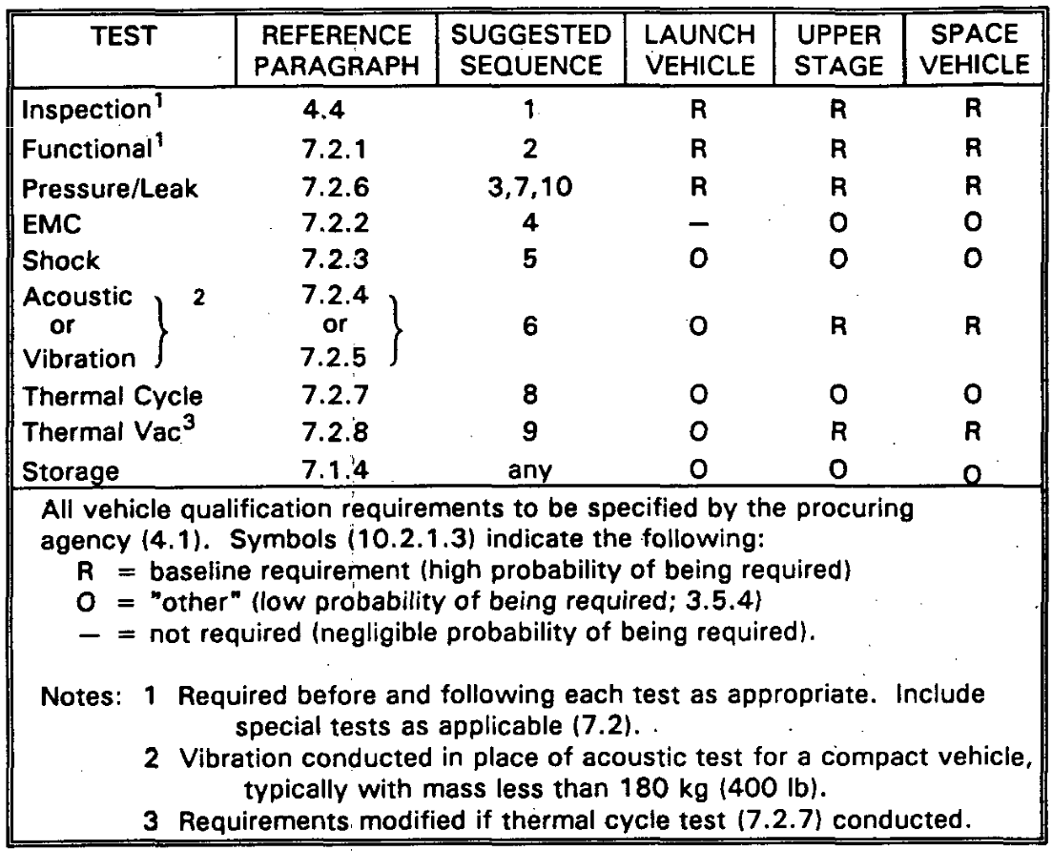
Test matrix
表2 MIL-STD-1540C（美军标）^{[2]}系统级验收试验矩阵
Vehicle Acceptance Test Baseline from MIL-STD-1540C

Slide 23
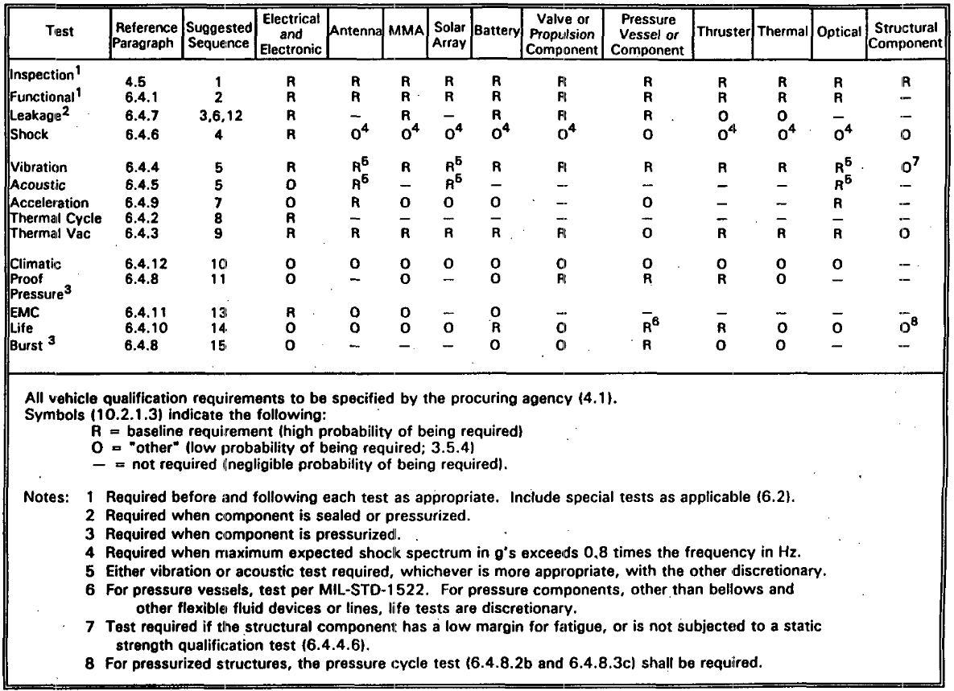
Test matrix
表2 MIL-STD-1540C（美军标）^{[2]}系统级验收试验矩阵
Unit Qualification Test Baseline from MIL-STD-1540C

Slide 24
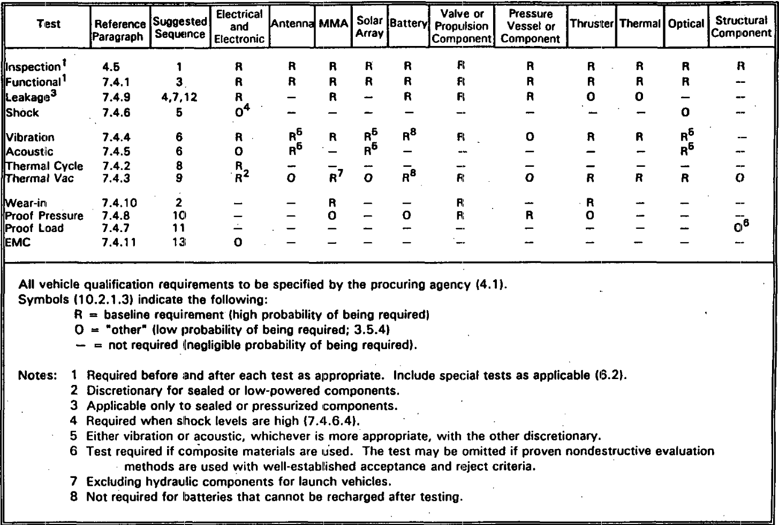
Test matrix
表2 MIL-STD-1540C（美军标）^{[2]}系统级验收试验矩阵
Unit Acceptance Test Baseline from MIL-STD-1540C

Slide 25
Test level
Test condition for vibration and shock test for ETRSS-1
Sine test level of satellite
Random vibration test level of satellite
Frequency/Hz | Acceptance | Qualification
5~8 | 5.86mm | 8.79mm
8~19 | 1.5g | 2.25g
19~100 | 2.0g | 3.0g
Sweep rate | 4oct/min | 2oct/min
Direction | X、Y、Z | X、Y、Z
Tolerance: Sine vibration:±10%; Frequency:±2%.
Frequency/Hz | Acceptance | Qualification
 | Acceleration PSD | Acceleration PSD
20~100 | +6dB/oct | +6dB/oct
100~175 | 0.04 | 0.08
175~430 | 0.20 | 0.40
430~600 | 0.04 | 0.08
600~2000 | -9dB/oct | -9dB/oct
Grms
Duration | 1min | 2 mins
Tolerance: Frequency ±2%； PSD ±1.5dB（20~1000Hz，），±3.0dB（1000~2000Hz）； Grms ±1dB Duration 0～10%
Shock test level of satellite
Frequency/Hz | LEVEL
100～500 | +12dB/oct
500～5000 | 1000g

Slide 26
Test level
Acoustic test level of satellite
1/3-Octave-Band Center Frequency (Hz) | Sound Pressure Level(dB) |  | Tolerance(dB)
 | Low Level | Acceptance Level
31.5 | 115 | 118 | ±5
63 | 128 | 131 | ±3
125 | 131.5 | 134.5
250 | 132 | 135
500 | 130.5 | 133.5
1000 | 124 | 127
2000 | 119 | 122
4000 | 115 | 118 | ±5
8000 | 111 | 114
Total Sound Pressure Level | 137 | 140 | ±1.5
Duration | 1min | 1min | 0～10%

Slide 27
Content
What is Environmental Test
What is Dynamic Environment
Dynamic Test Matrix and Level
Dynamic Test Example
Exercise

Slide 28
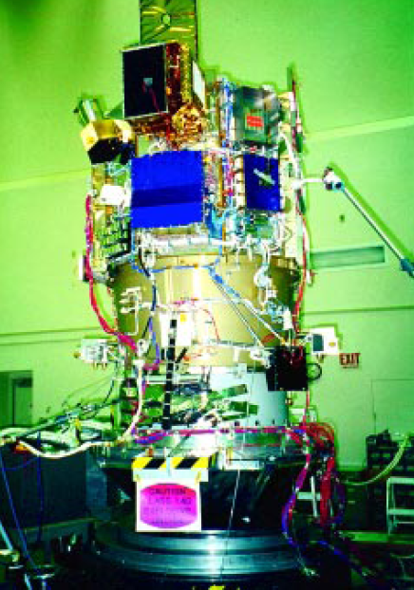
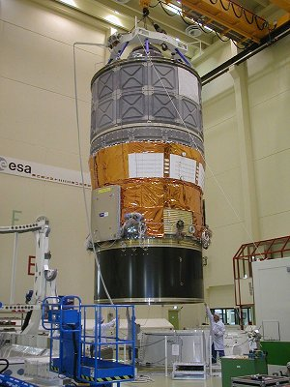
Dynamic Test Application
Vertical Vibration Test for NASA’s DS1
Vibration Test for ESA’s ATV-STM Spaceship
Notes:
80% TVt 应用

Slide 29
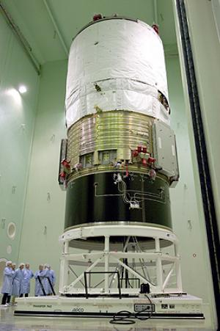
Acoustic Test for ATV-STM Spaceship
Notes:
80% TVt

Slide 30
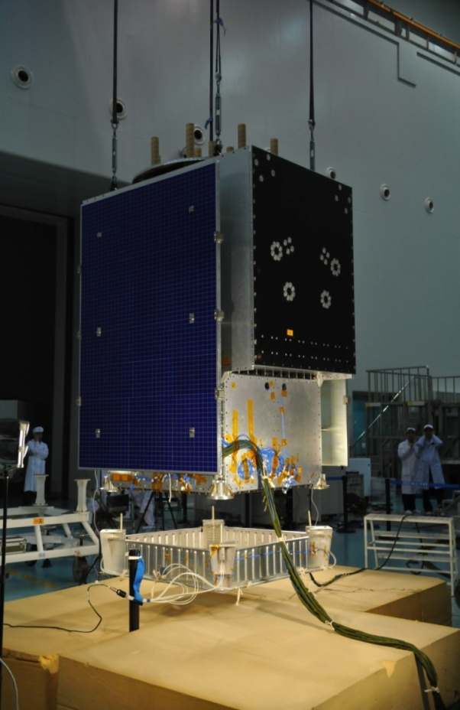
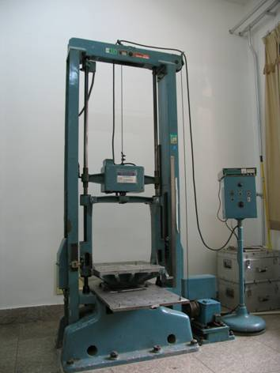
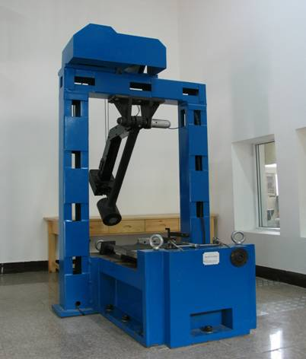
Shock Test For CAST-BD
Shock Test Equipments
Notes:
80% TVt

Slide 31
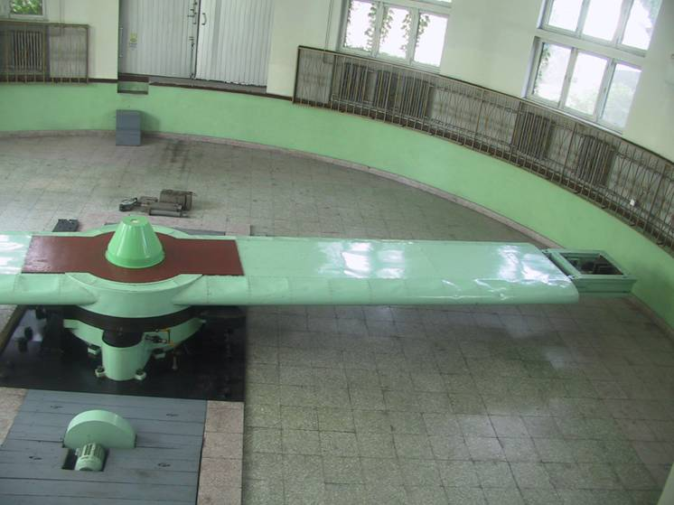
Acceleration Test Equipments
Notes:
80% TVt

Slide 32
Content
What is Environmental Test
What is Dynamic Environment
Dynamic Test Matrix and Level
Dynamic Test Example
Exercise

Slide 33
Q & A
1. What is Environmental test?
2. What is the objective of dynamic environment test?
3. What is the test matrix for unit level?

Slide 34
THANKE YOU FOR ATTENTION!
Notes:
80% TVt

